Slide 1

JAVA OOP: COURSE REGISTRATION SYSTEM
Presentation By:
Muhammad Affan Siddiqui
Ibrahim Ahmed Siddiqui
Muhammad Hassan Atiq
Zaid Tariq

Slide 2
WORK DONE BY:
25%
Ibrahim Ahmed Siddiqui
25%
Muhammad Affan Siddiqui
25%
25%
Muhammad Hassan Atiq
Zaid Tariq

Slide 3
Introduction
This project represents a Course Registration System where students can register for courses by providing their name, phone number, and email address. The goal of this project is to create a user-friendly graphical user interface (GUI) using the JavaFX library.
Features:
Students can register for courses by entering their personal information.
GUI elements such as text fields, buttons, and containers have been used to create an attractive user interface.
Object-Oriented Programming (OOP) principles have been applied to ensure code maintainability, reusability, and scalability.

Slide 4
Introduction
Classes:
CourseRegistrationSystem: This is the main class extending JavaFX Application.
It is responsible for initializing and arranging GUI components.
Technologies Used:
Java Programming Language
JavaFX Library for GUI
Object-Oriented Programming (OOP) Principles

Slide 5

01
USER GUIDE
GUI Screen Shot of Project.

Slide 6
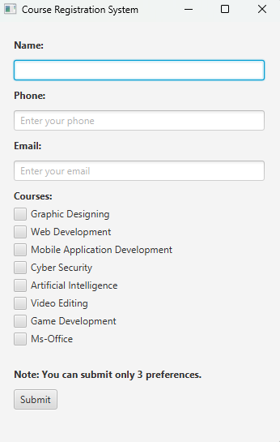
PROJECT GUI

Slide 7
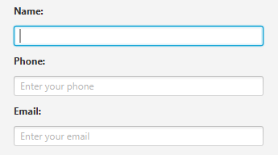
Enter your Full Name
Enter your Mobile Number
Enter your E-mail

Slide 8
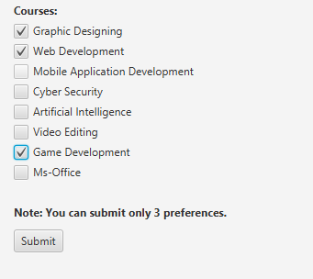
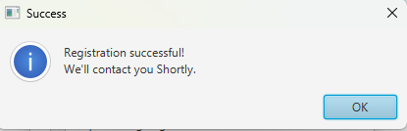
Select only 3 preferences by clicking on check box.
Click on Submit button to get registered.
Confirmation message will appear click okay.

Slide 9
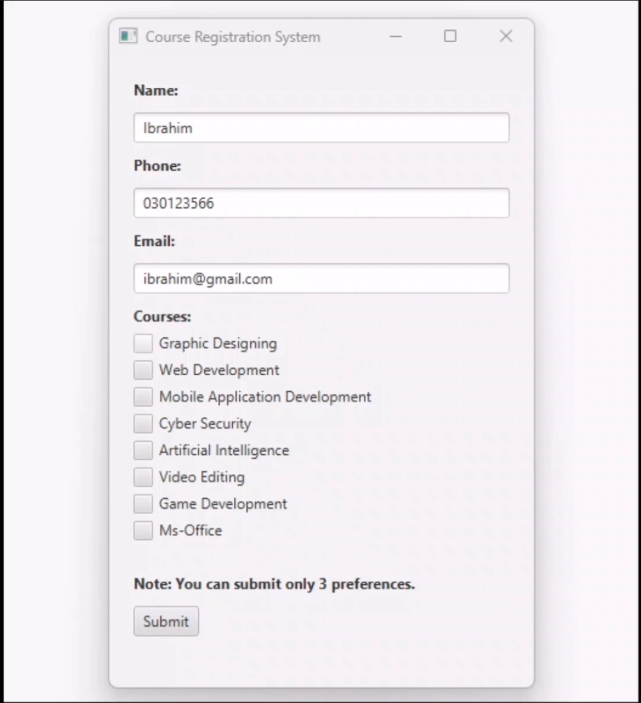
If more than 3 courses are selected the error will be shown. You have to select only 3 preferences.

Slide 10
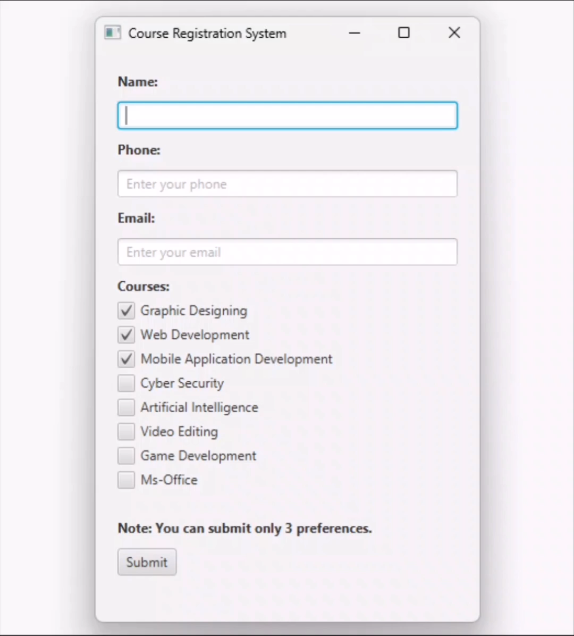
You have to select at least one course else it will throw error.

Slide 11
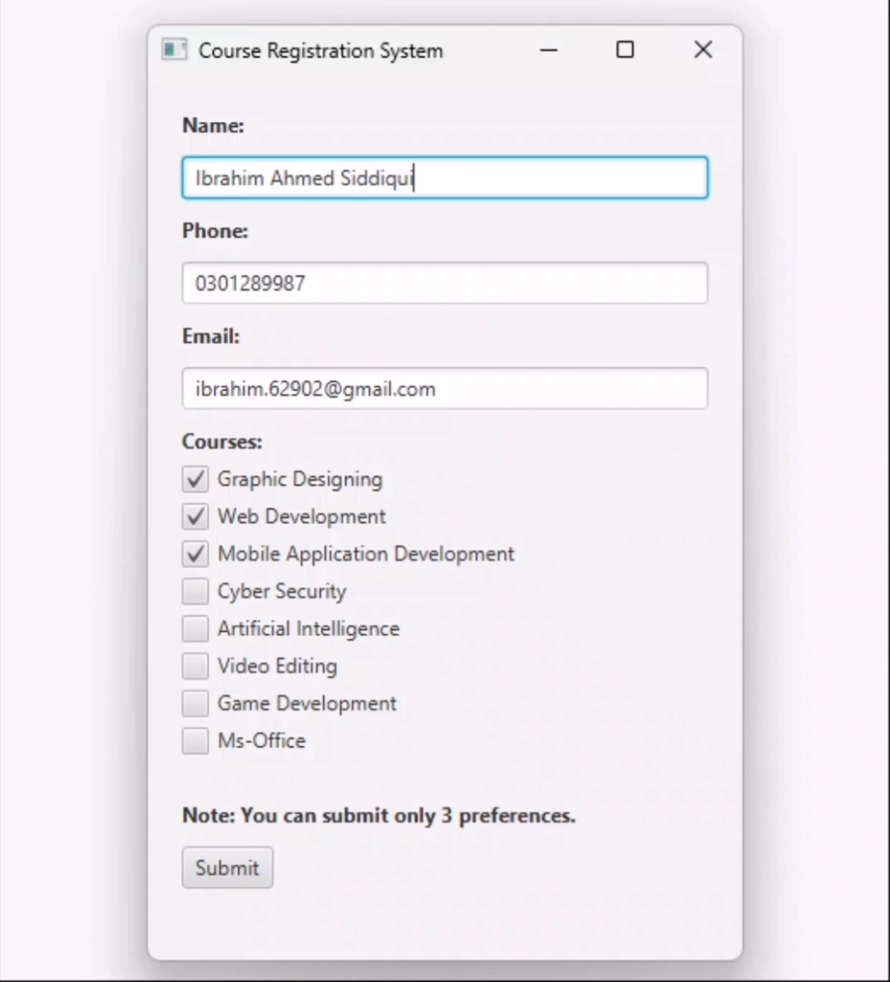
You have to enter your name, number & e-mail. Else Registration won’t go further it will show error

Slide 12
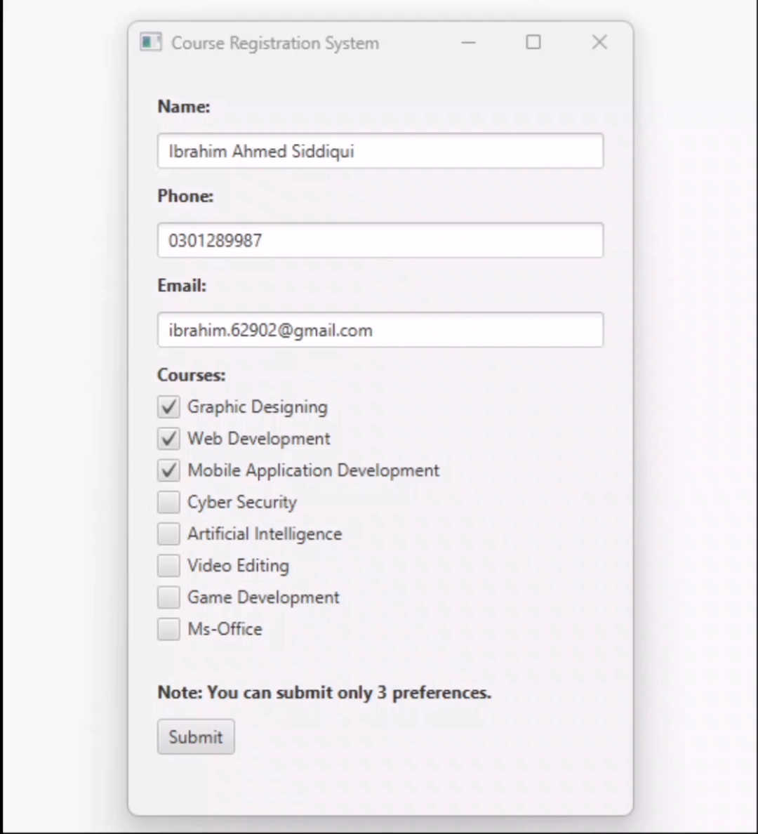
Correct way to use the application.

Slide 13

02
DEVELOPER GUIDE
Code Screen Shot of Project.

Slide 14
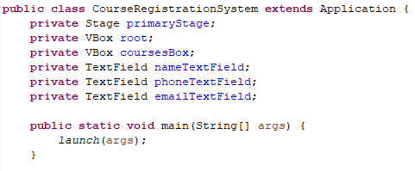
GRAPHICAL USER INTERFACE
The CourseRegistrationSystem class initializes the main window and UI layout.
Private is added so it is accessible by it’s own class.
Type of variable.
Stage represent single window in FX
Vbox represent a container holding elements vertically.

Slide 15
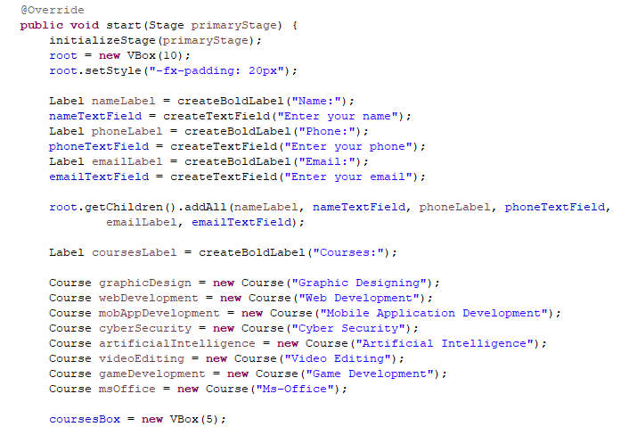
GRAPHICAL USER INTERFACE
Text fields for name, phone, and email are created using createTextField.
Label for name, phone, and email are created using createBoldLabel.
the code is adding several UI elements (labels and text fields) to the root container. This is a common practice in JavaFX for constructing a user interface. Each of these UI elements (nameLabel, nameTextField, phoneLabel, phoneTextField, emailLabel, emailTextField) likely represents a part of the form for entering information (name, phone, email) in the course registration system.
Course options are represented by checkboxes in the coursesBox VBox.

Slide 16
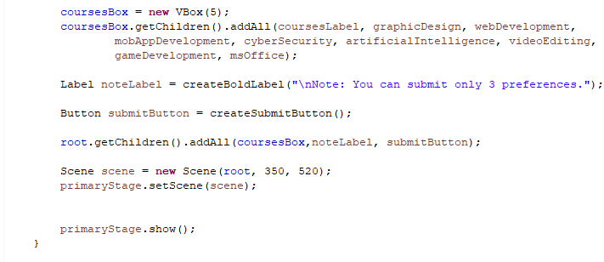
GRAPHICAL USER INTERFACE
A note label and submit button are added via createSubmitButton.
Create a scene with the main VBox and set it to the primary stage

Slide 17
LOGIC
Features:
The logic for collecting user input, validation, and exception handling.
Counts selected courses using the countSelectedCourses method
Exceptions:
The RegistrationException class handles errors during registration.
Course Representation (Course Class):
Represents a course as a checkbox (inherits from CheckBox).
Counting Selected Courses (countSelectedCourses method):
Uses polymorphism to iterate through checkboxes and count selected courses.

Slide 18
LOGIC
Button Action (createSubmitButton method):
Calls the registration logic in displayResultScene.
OOP Pillars:
Encapsulation, Inheritance, Polymorphism, and Abstraction are demonstrated throughout the code.

Slide 19
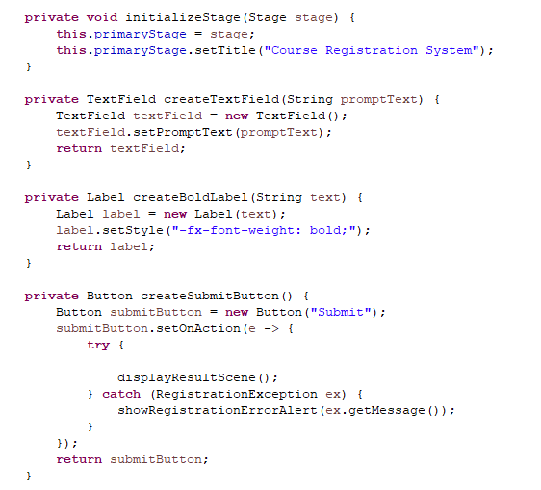
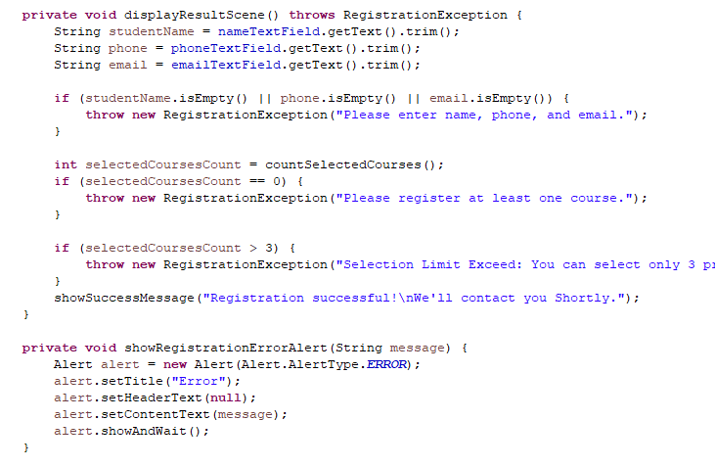
LOGIC

Slide 20
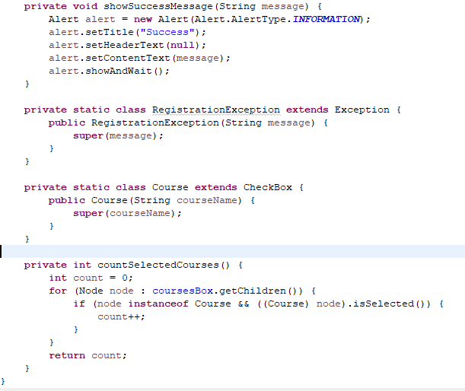
LOGIC

